Slide 1
The Research Agenda
for Occupational Therapy Education
AOT/ NBCOT 2013 Education Summit
October 5,2013

Slide 2
Background
Started in 2011 – A number of groups working on higher education issues identified the need to establish an agreed upon agenda for the profession addressing research and scholarship in occupational therapy education.

Slide 3
Rationale:
Need for outcomes to address:
Higher education agenda in the USA
Emerging education delivery models
Fieldwork needs
Entry-level degrees
Entry-level versus post-entry competencies to address the changing occupational needs of society and the healthcare agenda

Slide 4
Identified a work group:
Janice P. Burke, PhD, OTR, FAOTA.
Andrea Bilics, PhD, OTR/L, FAOTA.
Ellen Cohn, ScD, OTR/L, FAOTA,.
Gupta, PhD, OTR/L, FAOTA.
Debra Hanson, PhD, OTR.
Barb Hooper, PhD, OTR, FAOTA.
Neil Harvison, PhD, OTR/L, FAOTA.

Slide 5
Process
Data gathering:
e-mail survey to 2,255 faculty members- 520 (23%) responded.
Review of existing data: for example….
An international systematic mapping review of educational approaches and teaching methods in occupational therapy.
Authors: Hooper, Barbara; King, Robin; Wood, Wendy; Bilics, Andrea; Gupta, Jyothi
Source: The British Journal of Occupational Therapy, Volume 76, Number 1, January 2013 , pp. 9-22(14)
Publisher: College of Occupational Therapists

Slide 6
Process
Workshop I: Indianapolis 2012
Over 130 academics participated.
Developed a framework for understanding the needs and priorities in education
Identified the research questions/concerns:
What is the conceptual framework for OT education? What is the signature pedagogy? What is our capacity for education research? What are the most effective instructional methods?

Slide 7
Process
Workshop II: San Diego 2013
Using questions generated by the participants in the 2012 workshop created goals for a broad Research Agenda for OT education.

Slide 8
Research Agenda for OT Education

Slide 9
Overview of the Agenda
6 Research Categories
Major Research Goals for Each Category
Sample Research Questions

Slide 10
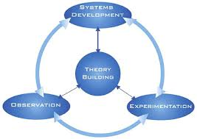
Research Category: Theory Building
Broad philosophies and theories
Core concepts
How concepts relate to one another
Hypothesizes how students learn
Delineates how education theories fit

Slide 11
Major Research Goals: Theory Building
Profession-specific theories for OT
Theory testing
Rigorously define how educational theories and approaches fit the OT profession context

Slide 12
Sample Questions: Theory Building
What is the nature of knowledge?
How do OT’s in occupation-centered practices process knowledge or what is the core logic behind occupation-centered practices?
How does the knowledge context of OT modify approaches adopted from the field of education?

Slide 13
Research Category: Pedagogy
Coherent conceptual foundation that informs the educator in how to facilitate and assess learning and influences how the learning context is utilized.
Notes:
(e.g., collaborative learning, competency based education, experiential learning, PBL, IPE, service learning, situated learning, etc.)

Slide 14
Major Research Goals: Pedagogy
Identify a signature pedagogy or pedagogies.
Evaluate the implementation of a signature pedagogy.
Test the effectiveness of signature pedagogy
Analyze match to educational theories and approaches
Identify and develop an optimum progression of pedagogical practices across the levels of entry

Slide 15
Sample Questions: Pedagogy
Is there a signature pedagogy?
what is it?
is it effective toward improving practice?
How does inter-professional education [or insert other pedagogies such as PBL, TBL, etc] relate to a signature pedagory?

Slide 16
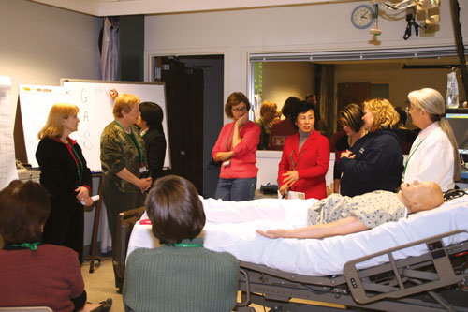
Research Category: Instructional Methods
Specific strategies used to promote learning.
Notes:
(e.g. tutorials, reflective journals, cases, concept mapping, lecture, technology, simulation, etc.)

Slide 17
Major Research Goals: Instructional Methods
Given a particular pedagogy, identify best practice instructional methods that maximize learning.
Identify optimal, coherent systems within which instructional methods can achieve entry-level competency.

Slide 18
Sample Questions: Instructional Methods
Given the profession’s developing signature pedagogy, what instructional methods/strategies are a strong fit? Which are effective?
What constitutes “evidence-based” in occupational therapy education?
What are the most effective instructional processes related to FW?

Slide 19
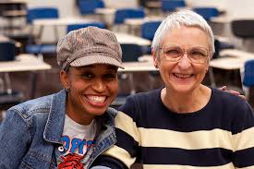
Research Category: Learner Characteristics & Competencies
Features of the learner, including, but not limited to, age, abilities, experiential background, cultural background, etc. and how these characteristics interact with the acquisition of competency

Slide 20
Major Research Goals: Learner Characteristics & Competencies
Identify learner characteristics across diverse populations consistent with success.
Identify educational program characteristics and practices which effectively support diverse student success.

Slide 21
Major Research Goals: Learner Characteristics & Competencies
Identify supports and barriers for collaborations among national data sources,
Create performance-based tools for measurement of different levels of competency.
Identify behavioral, social and professional entry level competencies.

Slide 22
Sample Questions: Learner Characteristics & Competencies
What is the trajectory by which students adapt to graduate education?
What administrative practices are related to successful academic performances?
What are learner needs associated with successful performance on FW?
What is the longitudinal process of competency attainment from student to entry-level

Slide 23
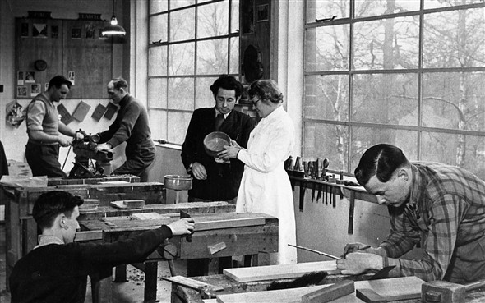
Research Category: Socialization to the Profession
The process by which students adopt as their own the knowledge, skills, culture and ethos of occupational therapy; building professional identity

Slide 24
Major Research Goals: Socialization to the Profession
Identify best educational practices for socialization to the occupational therapy profession.
Identify the factors that shape professional identity and the development of occupation-centered and evidence-based practice.
Identify the points of influence for the professional socialization of OT educators.

Slide 25
Sample Question: Socialization to the Profession
How do students assume an identity as an occupational therapists?
What educational approaches
facilitate students’ professional identity?
facilitate students’ engagement with larger issues of the profession?

Slide 26
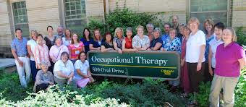
Research Category: Faculty Development & Resources
The process by which educators/FW educators acquire/maintain knowledge, skills and attitudes for …
Teaching,
Researching occupational therapy education,
An identity as OT educator
Core ideas of occupation

Slide 27
Major Research Goals: Faculty Development & Resources
Effective Education
Effective methods to prepare faculty to implement best practices in OT education.
Continuum of educator competencies from clinician to master educator.

Slide 28
Major Research Goals: Faculty Development & Resources
Effective Research
Identify trajectories and supports by which educators become researchers.
Identify processes that support ongoing scholarship of teaching and learning.
Pilot educational research training programs.

Slide 29
Sample Questions: Faculty Development & Resources
Longitudinal process of competency attainment from practitioner to educator? What constitutes “valuing” and “recognizing” educational research?
What processes are effective for building capacity in educational research?
Best practice in faculty development?

Slide 30
The Research Agenda
for Occupational Therapy Education
AOT/ NBCOT 2013 Education Summit
October 5,2013

Slide 31
Overview
Research

Slide 32
OverView

